Slide 1
Team 24 - Ground Penetrating Radar
Tyler Castro, Daniel Miller, Coy Coburn, Michael Turner
Objective: To create a ground penetrating radar system to serve as a non-destructive method for mapping plant root systems
Control Unit
Transmitter Circuit
Receiver Circuit
Direct Signal
Transmitter Antenna
Receiver Antenna
Transmitted Pulse
Reflected Pulse
Buried Object

Slide 2
System Deliverables
Transmitted signal will reach a ground depth of at least 0.7 m and up to 1.2 m
The spatial resolution will be at most 7.62 cm (3 inches)
One working channel from transmitter to receiver circuitry
Two vivaldi antennas that are specifically designed to transmit through sand at 2.4025 - 2.4775 GHz.
Record digital data into files that can be sent to systems for image processing

Slide 3
Transmitting Circuit Daniel Miller
Power Splitter
VCO
PA
To antenna for transmitting
Sawtooth
(Function Generator)
Major Hurdles:
10 MHz Bandwidth (VCO sensitivity)
Signal needed to be 80 mVpp
Frequency = 68.065 (Voltage) + 2268.8
Excess noise
Starting voltage (>2 V)
To receive circuit for frequency matching

Slide 4
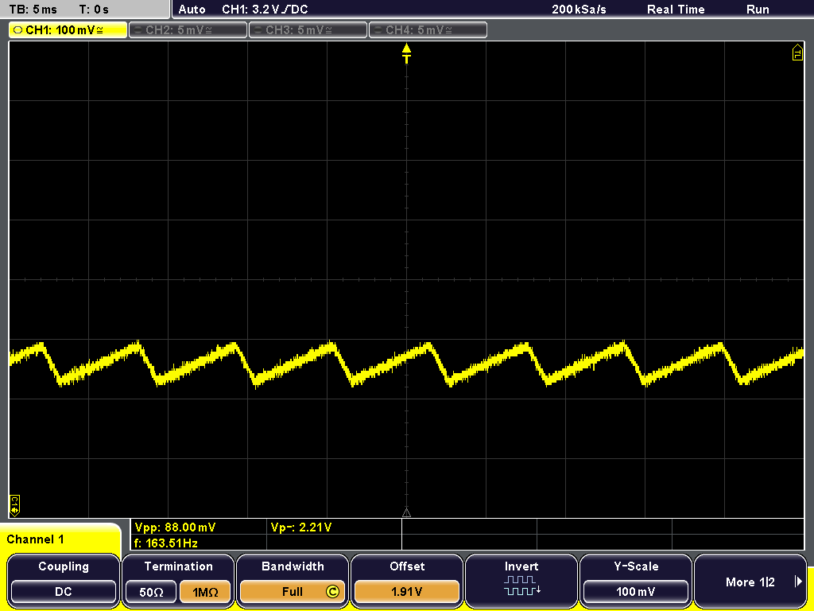
Transmitting Circuit Results
Output from function generator (figure 1)
2415-2425 MHz
Could not test output from VCO
Vpp = 88mV
Vp = 2.21 V
Figure 1

Slide 5
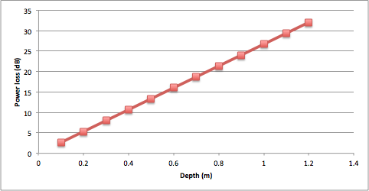
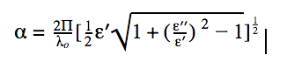
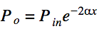
Transmitting Circuit - Penetration Depths
Sand
ε’= 6
ε’’=0.3
Requires minimum of -17dBm but will transmit 1 W

Slide 6
Transmitting Solutions/Improvements
Excess noise
Use DDS or NCO in place of function generator and VCO
Power output
Have several gain stages with a variable attenuator
Decouple power supply

Slide 7
Transmitting and Receiving Antennas
Tyler Castro
Two Vivaldi Antennas
Tx
Rx
Signal from Transmitting Circuit
To Receiving Circuit
RF Choke
RF Choke
Major Hurdles:
Antennas created without substrates, which decreases cost of production, but limits reference resources available
Difficult to achieve a reliable connection from cable to antenna using EIC soldering materials
Baluns needed in order to eliminate crippling signal loss
Hand-made antenna ineffective from warping of metal during cutting
Testing and perfecting difficult due to need to recreate antennas after each failure

Slide 8
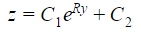
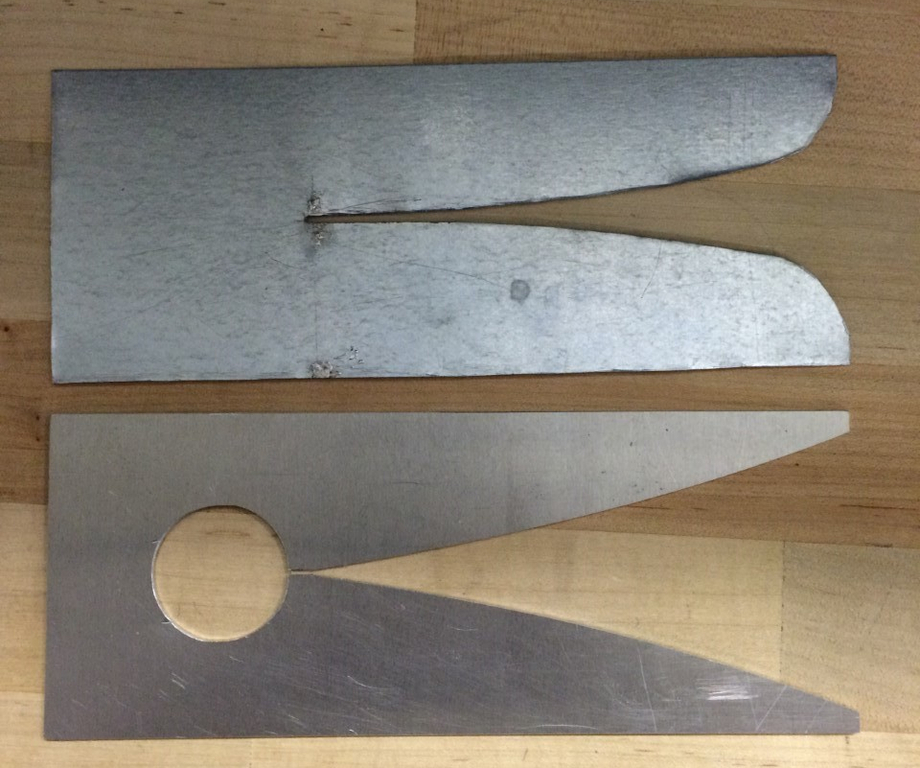
Antenna Results
Two versions currently created
Both cut from steel sheet metal due to very low cost
Curvature of slotline created using the following equation:
Version 1 (top) was cut by hand, using a rate of expansion, R, of .2
Version 2 (bottom) was cut using the EIC milling machine, with a rate of expansion of .1, and includes a radial slotline stub
Specification | Min | Nominal | Max
Operating Frequency | 2.4025 GHz | N/A | 2.4775 GHz
Length of Tapered Slot | .125 m | .126 m | N/A
Width of Tapered Slot | .0625 m | .0635 m | N/A
Diameter of Circular Slot Stub | .0306 m | .0406 m | .0306 m

Slide 9
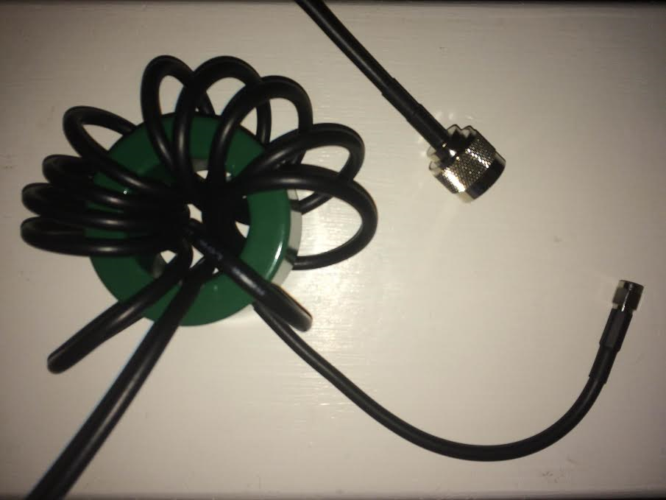
Antenna Solutions
Testing of version 1 revealed almost complete reflection of the signal, due to:
Antenna sides no longer being coplanar from warping during cutting (solved through mill cutting)
Unreliable connection using soft solder
To achieve a solid connection for version 2:
Switch to a hard solder that can bind to steel
To prevent current flow on the outside of the coaxial
cables:
Two RF chokes act as baluns for
the antennas
Coiled cables around ferrite cores act
as inductors, creating reactance along
the outer edge of the cable, preventing
current flow

Slide 10
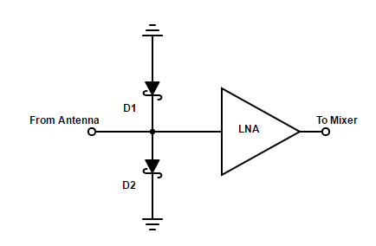
Receiver Circuit
Team member: Michael Turner
Major hurdles:
Original design over complex
Originally 4 channels planed
PIN diode shunt switch and driver removed
Problems with ordering parts
Couldn't easily test circuit
Advanced Design System couldn’t simulate several stages properly
Lack of initial knowledge about RF led to many mistakes

Slide 11
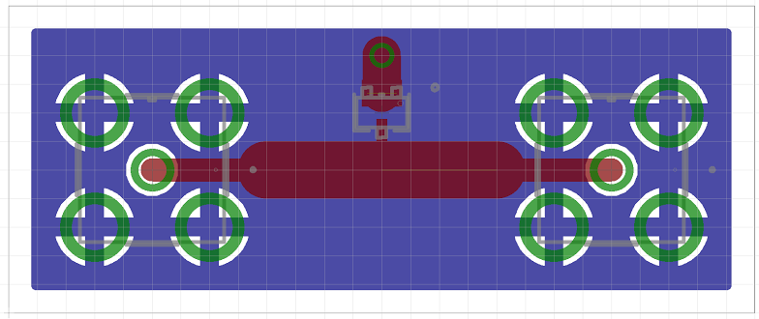
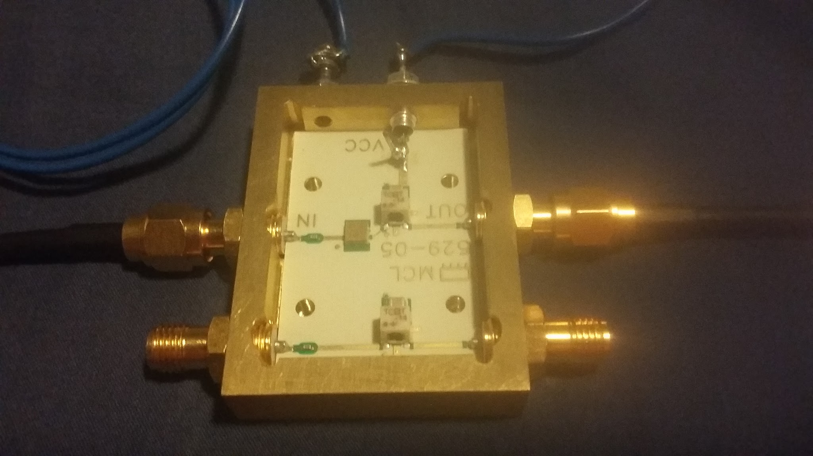
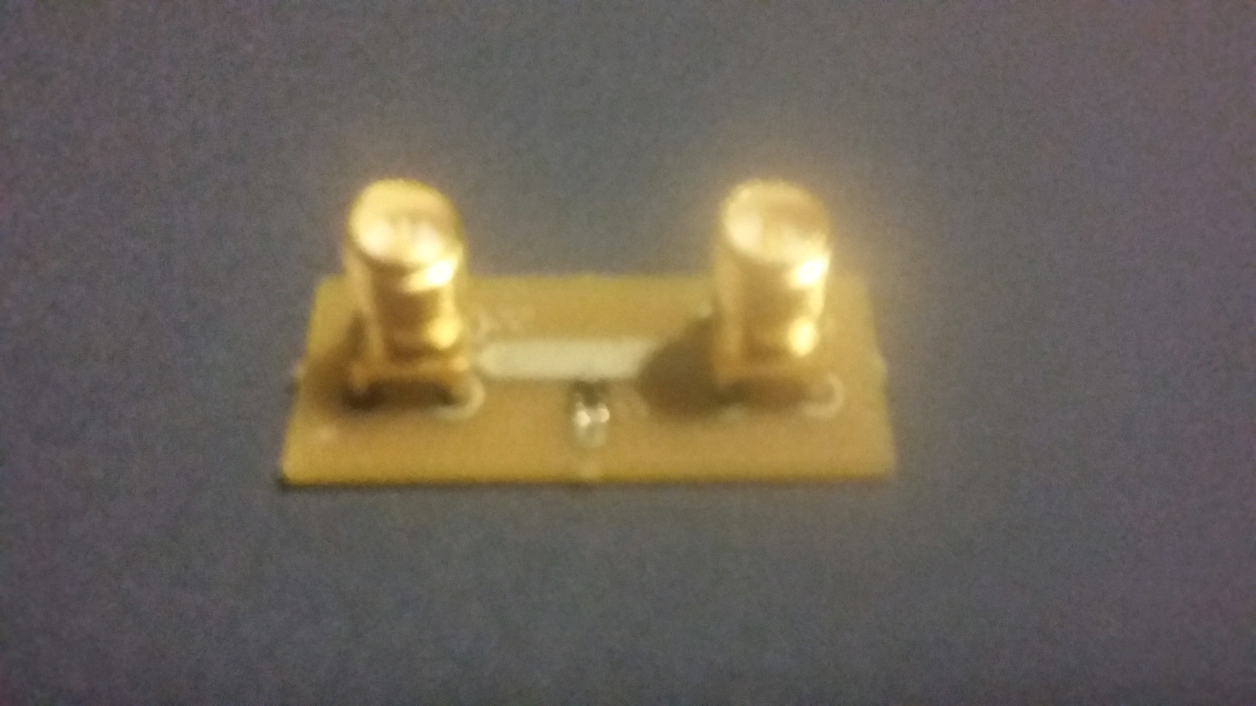
Results and Solutions:
Schottky diode LNA
Variable | Value | Unit
Frequency Range | 0.05 - 4 | GHz
Gain | 13.3 | dB
Noise Figure | 0.95 | dB
Output @ 1db | 20.7 | dBm
Max Input Power | 17 | dBm
Variable | Value | Unit
Forward Voltage | 700 | mV
Diode capacitance | 1 | pF

Slide 12
Receiver Conversion
Coy Coburn
Receiver Conversion Subsystem
Rx MIXER
ADC Driver
Schottky
LNA
LPF
AAF
RF
IFP
IFN
ADC
LO
Power Splitter
Major hurdles:
Subsystem depends on LO and Rx signal
Expected IF of ~200kHz, can differ due to frequency rise/fall overlap
High cost for many parts including Mixer, Power splitter, and ADC
Lack of breadboard prototyping
Bandwidth of 5MHz, SMA board connections, noise sensitive circuitry
Finding necessary processor to handle high-speed ADC sampling rate
AD9280 takes 32Msps, AD9656 takes 125Msps

Slide 13

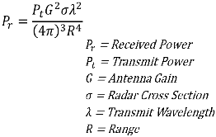
Results and Solutions
Advanced Design System was used to simulate circuitry
I recommend for next year’s team to create new PCB’s every 2 weeks for circuit improvements
Been in constant contact with Scott Shoaf, a Field Apps Engineer from Analog Devices
Has lended a AD9656, eval board, and HSC-ADC-EVALCZ, a FPGA data config kit
Buy chips’ bare boards and populate with components according to datasheet to lower cost
Variable | Value | Unit
Cs | 1.244E8 | m/s
Pt | 20 | dBm
G | 7 | dBm
f | 2.45E9 | Hz
R | 1.2 | m
ƛ | 5.0E-2 | m
Pr | -28.165 | dBm
fDEV | 5.0E6 | Hz
Ts | 5.0E-3 | s
fB | 194E3 | Hz

Slide 14
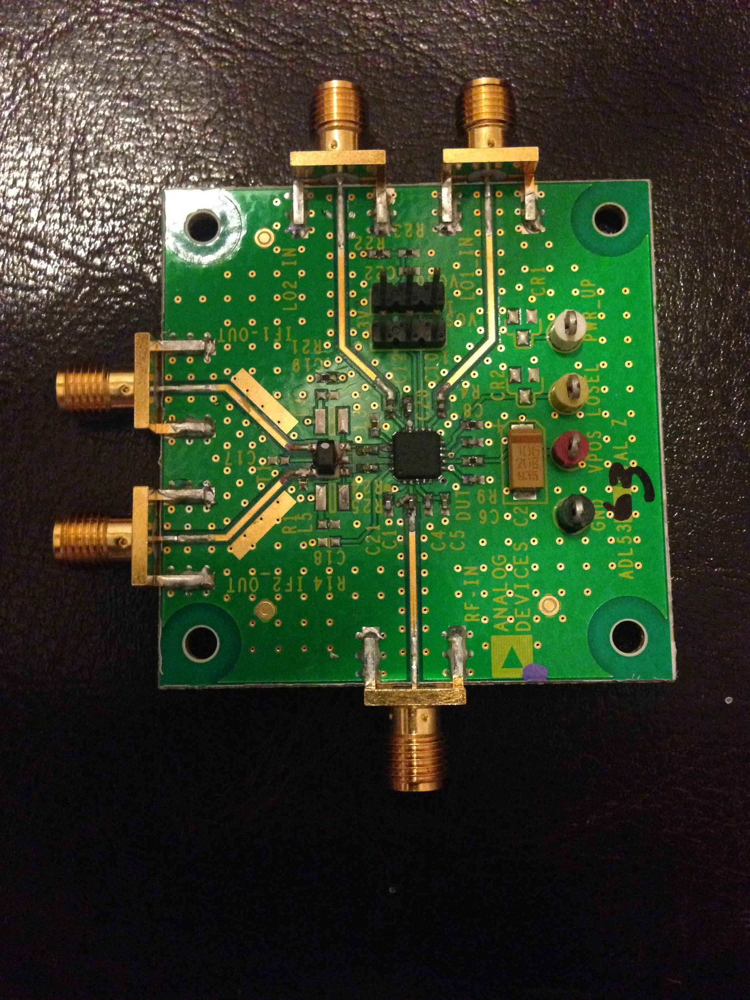
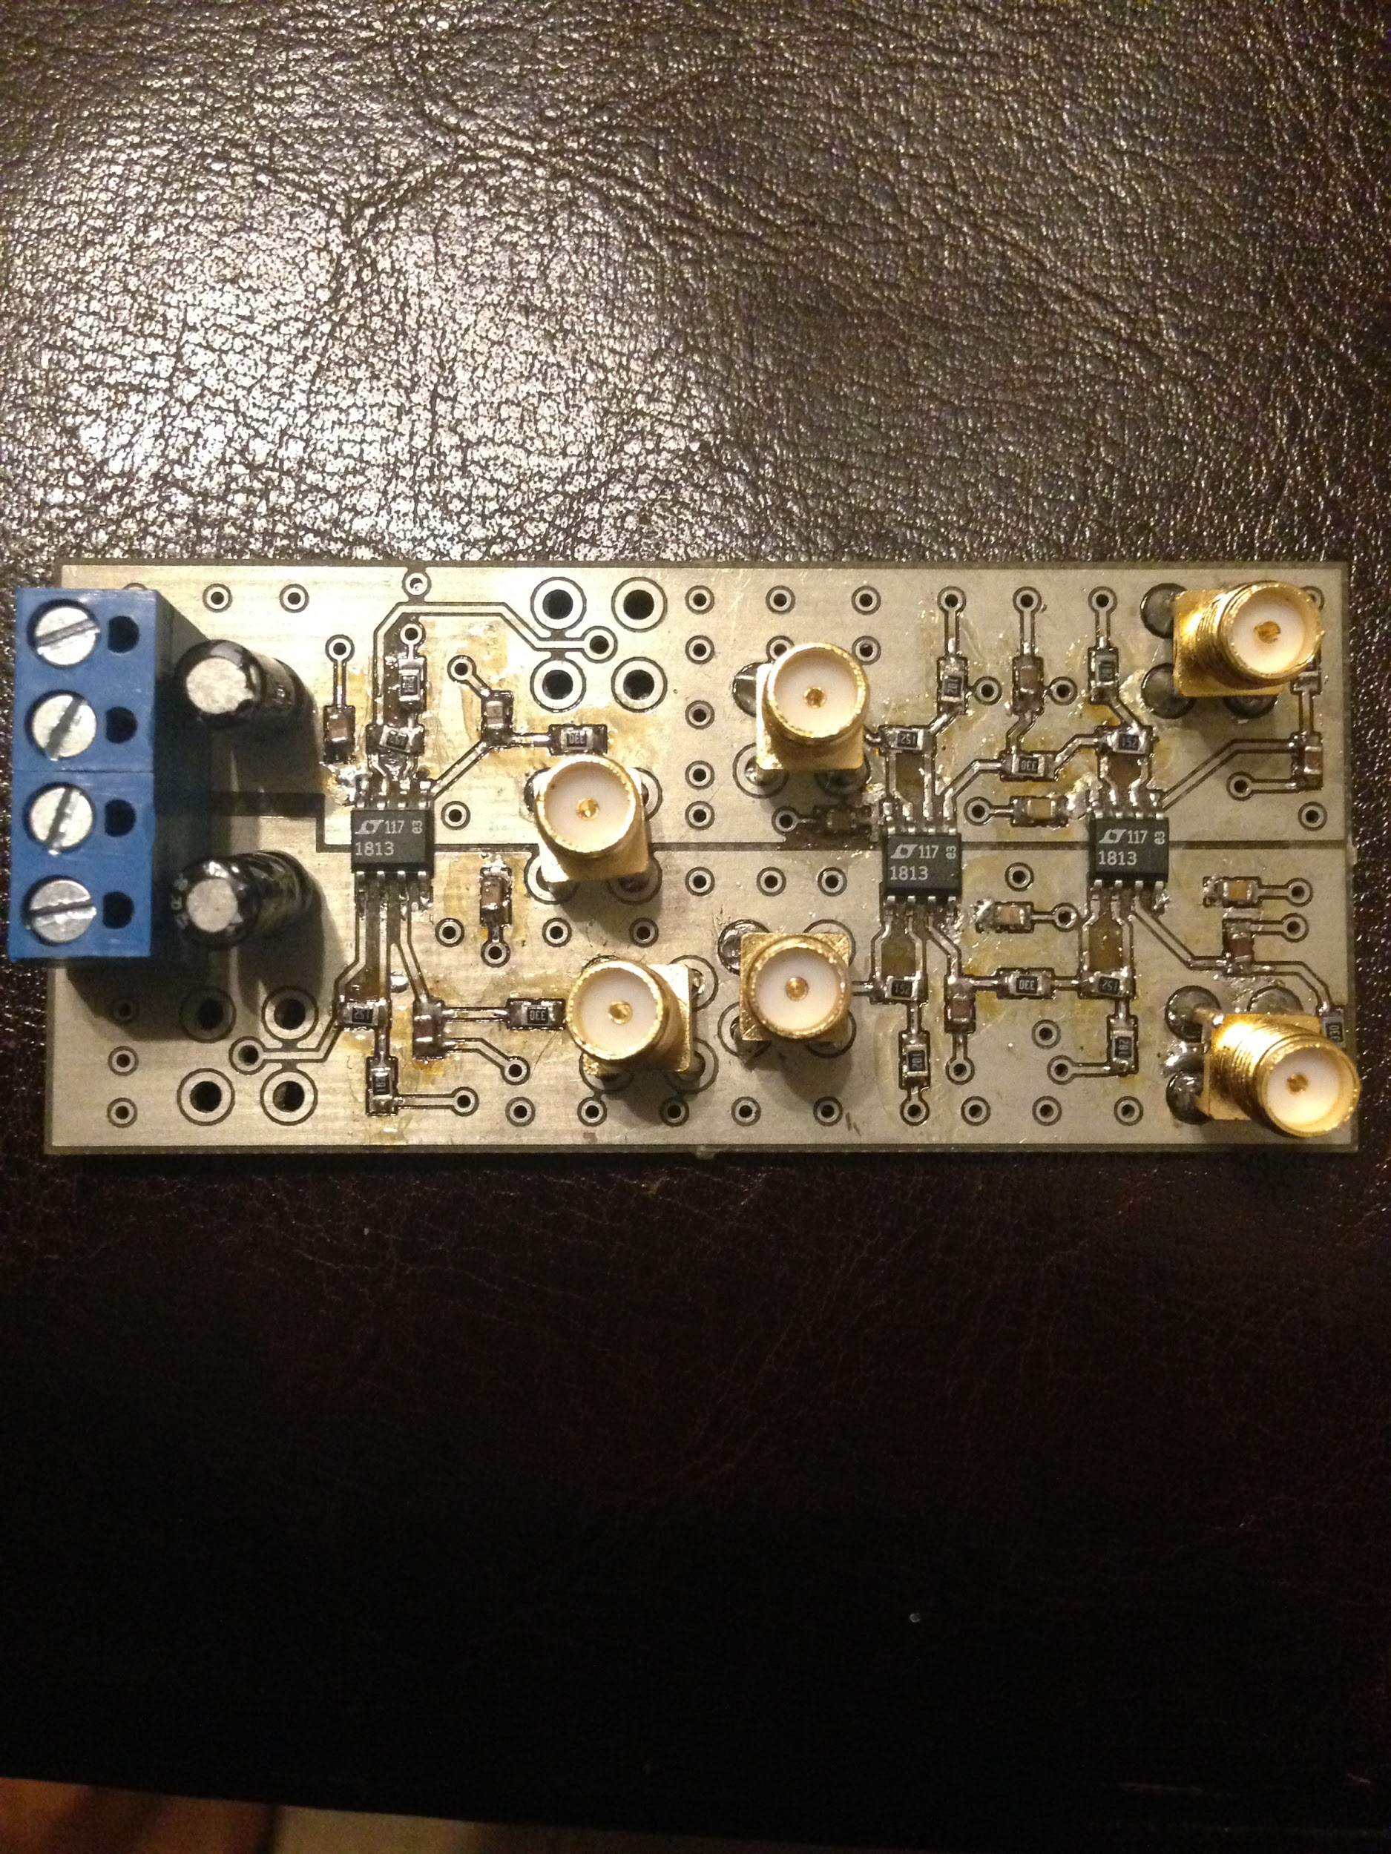
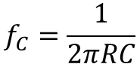
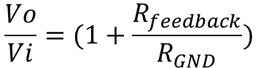
Mixer stage board
LPF and AAF stages board
AAF
LPF
IFP IFN
IFN
IFP
LO1
LO2 (unused)
RF
Variable | Value | Unit | Source set
ADC bits | 8
Resolution | 256 | bits
Resol % | 0.00390625 | %
Vo Range (3VDD) | 2.9 | V
Vo Range (5VDD) | 4.4 | V
Voltage diff level | 0.011328125 | V | 3VDD
Voltage diff level | 0.0171875 | V | 5VDD
Variable | Value | Unit
R | 33 | Ω
C | 18 | nF
fc | 267 | kHz
Rfeedback | 1.5 | kΩ
Rgnd | 1.0 | kΩ
Vo/Vi | 1.5 | dB

Slide 15
Conclusion
While unable to completely reach our intended results, each subsystem has been calculated and established in accordance with our simulations.
Our work this semester provides a solid foundation for the next team who decides to continue this project.
Continuing on, additional improvements can be made to each subsystem, integration needs to be completed, housing for components needs to be created, and additional parts are needed to process the samples (ADC and FPGA).

